Slide 1
KITETE REGIONAL REFERAL HOSPITAL
TABORA
FACULTY OF MEDICINE
DEPARTMENT OF INTERNAL MEDICINE
TOPIC: GIT BLEEDING(UPPER & LOWER)
DR GODFREY. O. BUSANJI

Slide 2
Case presentation
NAME: PROSPER WILFRED
AGE: 29YRS
SEX:M
ADDRESS: UYUI
TRIBE: NYAMWEZI
OCCUPATION: TAILOR
RELIGION: CHRISTIAN
EDUCATION LEVEL: STANDARD SEVEN
MARITAL STATUS: MARRIED
NEXT OF KIN: MOTHER
REFERRAL: SELF FROM HOME
DAYS IN WARD : 3DAYS

Slide 3
C/C:
ABDOMINAL PAIN 3/7
VOMITING 1/7
HPI: the patient presented with abdominal pain three days prior to admission, which was of sudden onset of abdominal pain which was sharp and burning in nature, it was located on the upper part of the abdomen, it was gradually increasing and radiating to the back. The pain had no specific periodicity although it was aggravated by hunger and it was relieved by eating food.

Slide 4
the patient reported that 1 day prior to admission, he presented with vomiting which was projectile in nature ,his vomitus contained fresh blood, mixed with food (5 times) it has no specific periodicity,was aggravated with food intake and was associated with nausea and also had a history of passing of dark coloured stool.
The patient reports to be an alcohol drinker and smoker. The patient denies any history of, weight loss, yellowish discoloration, painful swallowing and passage of fresh blood from the anus . The patient has no history of abdominal distention, awareness of heartbeat, chest pain, heartburn, lower limb swelling and dizziness and fainting.

Slide 5
.
ROS
  GUS; The patient had no history of pain during urination, inability to pass urine or the need to urinate frequently
  RS; No hx of cough, chest pain, shortness of breath
  MSS; No hx of muscle weakness or pain, painful joints, swellings of joints
  ENT; no hx of discharge from ear/nose, no hx of pain in nose, throat/ear, no hx of throat swellings
  CNS; no hx of LOC, convulsions, fever,

Slide 6
PMHx
    1st admission
    No hx of surgery
    No hx of BT
    No hx of drug/food allergy
    No hx of chronic illness
FMSHx
    Married with two children – all are well
    His mother has history of PUD
    Drinks alcohol (1 small bottle of konyagi per day, alternates with beer)
    He smokes 7 cigarettes per day for 4 years

Slide 7
Nutritional HX
Eats at least three times a day
  Morning; tea, bread/chapati, eggs, soup
  Afternoon;sometimes he doesn’t eat lunch but when he do he takes ugali, meat/fish, veges,
  Night;soup and grilled meat

Slide 8
Examination
G/E:
    Alert, oriented (P,P,T), afebrile (36.7⁰C),hydrated, not cyanosed, not jaundiced, not pale, no enlarged lymph nodes, no palmar erythema, no finger clubbing,no lower limb edema
    VITALS
      BP: 108/70mmHg
      PR: 101bmp
      RR:19cylces/min
      Temp: 36.7 ⁰C
Local/ GIT:
  Inspection:
    Abdomen was symmetrical with normal contour, the abdomen was not distended nor scaphoid, no visible pulsation, no visible marks or surgical scars, no visible veins/ peristalsis,pt pointing the tender spot at the mid epigastrium
  Palpation:
    Tenderness on superficial and deep palpation on epigastric region, no rebound tenderness, so splenomegaly, no hepatomegaly
    Auscultation:
    5 bowel sounds in 1min heard
  Percussion:
    Tympanic sound

Slide 9
CVS
  PR-101bpm full volume and regular, synchronous with other pulses, BP- 108/70mmhg
  Not dyspneic, no neck distention or visible neck pulsation, no precordial bulging or hyperactivity.
  apex beat at 5th ICS mid-clavicular line, no thrill
  S1 and S2 heard, normal heart sounds
  Hepatojugular reflex was negative

Slide 10
RS
  Insp ; (RR-19bpm), normal chest morphology, no scars, no swellings, no nasal flarring
  Palp; Trachea centrally located, symmetrical chest expansion, no chest tenderness, no palpable mass.
  Resonant on percussion.
  Auscultation; normal breath sounds

Slide 11
CNS
  Higher centers
  Oriented GCS 15/15, Long& Short memory-Intact, Judgment-Good
  Cranial Nerves
    All intact
  Motor Examination-Intact
  Sensory Examination-Intact

Slide 12
Diagnosis
PDX: upper GI Bleeding 2⁰ to PUD
Ddx; esophagitis, gastritis
PLAN;
  Investigations done
    Hb level: 10.1 g/dl
    Blood Group + Cross-matching : AB Rh+
    MRDT: negative
    RBG: 10.1 mmol/L
    Investigations to be done
    H.pylori Faecal antigen test
    Oesophago-gastro-duodenoscopy ,OGD

Slide 13
Treatment
Resuscitate the patient
Open iv line for fluids
Catheterization
NGT
Pharmacological
IV normal saline and pantoprazole IV 80mg stat then infusion 8mg/hr for 3 days

Slide 14
UPPER GI BLEEDING

Slide 15
Contents
Introduction
Epidemiology
Causes of upper gi bleeding
Clinical presentation of upper gi bleeding
Types: variceal and non variceal bleeding
Differential diagnoses
Management
Causes of lower gi bleeding
Clinical presentation of lower gi bleeding
Management
Case presentation
Questions

Slide 16
INTRODUCTION
Acute Gastrointestinal (GI) bleeding is a potentially life-threatening abdominal emergency.
Upper gastrointestinal bleeding (UGIB) is defined as bleeding derived from a source proximal to the ligament of Treitz. (Also known as a suspensory ligament of the duodenum)
The GI or digestive tract extends from the mouth to the anus.
GI tract is conventionally divided into upper (mouth to ileum) and lower (cecum to anus)

Slide 17
INTRODUCTION cont
From the point of view of bleeding, the demarcation between upper and lower GIT is the duodenajejunal junction; bleeding above the duodenaojejunal junction is called upper GI bleeding and below the junction is called lower GI bleeding.
In endoscopy, the upper GIT includes; esophagus, stomach and duodenum (esophagogastroduodenoscopy OGD or upper GI endoscopy) and the lower includes; anus, rectum, colon, cecum (anoproctosigmoid colonoscopy or lower GI endoscopy)

Slide 18
Epidemiology
Upper GI bleed remains a major medical problem.
About 75% of patient presenting to the emergency room with GI bleeding have an upper source.
In-hospital mortality of 5% can be expected.
The most common cause are peptic ulcer & oesophageal varices.

Slide 19
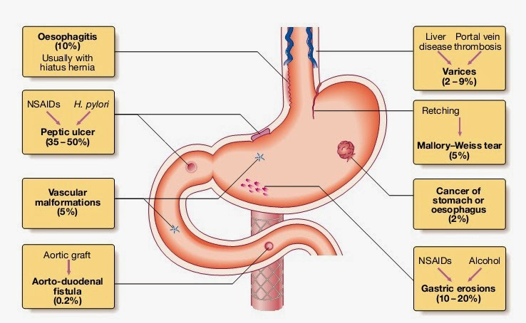
CAUSES OF UPPER GI BLEEDING

Slide 20
CLINICAL PRESENTATION
SIGNS
Syncope
Hematemesis
Melenemesis
Melena
Haematochezia
Epigastric pain
Dyspepsia
SYMPTOMS
Dizziness
Weakness
Vomiting blood (coffee ground)
Diffused abdominal pain
Weight loss
NB; A person with upper gastrointestinal bleeding may also present with complications of anaemia, including chest pain, fatigue and shortness of breath.

Slide 21
Cont
The physical examination performed by the physician concentrates on the following things:
Vital signs, in order to determine the severity of bleeding and the timing of intervention
Abdominal and rectal examination, in order to determine possible causes of haemorrhage
Assessment for portal hypertension and stigmata of chronic liver disease in order to determine if the bleeding is from a variceal source.

Slide 22
UPPER GI BLEEDING IS CLASSIFIED INTO TWO
Variceal bleeding: includes gastro-esophagial varices, portal hypertension gastrophy
Non variceal bleeding: includes PUD, mallory weiss tear, tumors and others

Slide 23
DIFFERENTIAL DIAGNOSIS
Peptic Ulcer Disease (PUD)
Gastritis / Duodenitis
- Subset due to NSAID use
Varices from portal hypertension
Mallory-Weiss tears at GE junction
Esophagitis
Malignancy
Dieulafoy’s lesion
Nasopharyngeal bleed – swallowed blood
Other- Aortoenteric fistula, angiodysplasia, Crohn’s, hemobilia, hemosuccus pancreaticus

Slide 24
1. Variceal bleeding
Causes of esophageal varieces (RISK FACTORS)
Diagnosis
management

Slide 25
GASTRO-ESOPHAGIAL VARICES
These are dilated submucosal veins dictated at the lower third of the esophagus and the proximal stomach.
These varices are the portosystemic collaterals that form after pre existing vascular channels dilated by portal hypertension.
The lower third of the esophagus drains to the superficial collateral veins of the esophagus and to the left gastric vein[ coronary vein] then directly to the portal vein.

Slide 26
It is highly associated with portal hypertension
RISK FACTORS
Alcohol abuse
Liver disease
Portal vein thrombosis
Liver cirrhosis

Slide 27
Clinical features
Bleeding varices present with
Hematemesis : acute onset and large volume
Melena
Syncope
Liver symptoms: jaundice,ascites,splenomegally,spider angiomastes
WHILE: Non bleeding varices are asymptomatic in most cases

Slide 28
Diagnosis
The gold stardand is by esophagogastroduodenoscopy ( OGD)
whereby it may reveal
A bleeding varices
Presence of red-wale sign
Presence of white nipple sign
These signs tend to show a varice which has bled recently or is goig to bleed.

Slide 29
Grades of esophageal varices
Grade 1
Dilated veins are visible but no protusion into the lumen
Grade 2
Dilated veins protuded to the lumen
Grade 3
Normal mucosa seen in between th dilated veins
Grade 4
No mucosa seen

Slide 30
ENDOSCOPIC THERAPY
Endoscopic intervention is only required in Forrest Ia, Ib, IIa and probably IIb at first to stop the active bleeding (Ia, Ib) and prevent subsequent rebleeding.

Slide 31
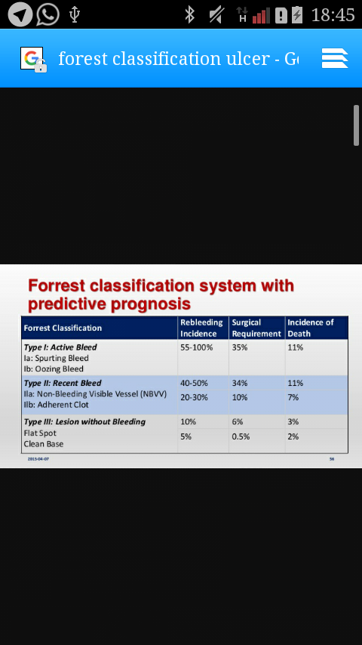
FORREST CLASSIFICATION

Slide 32
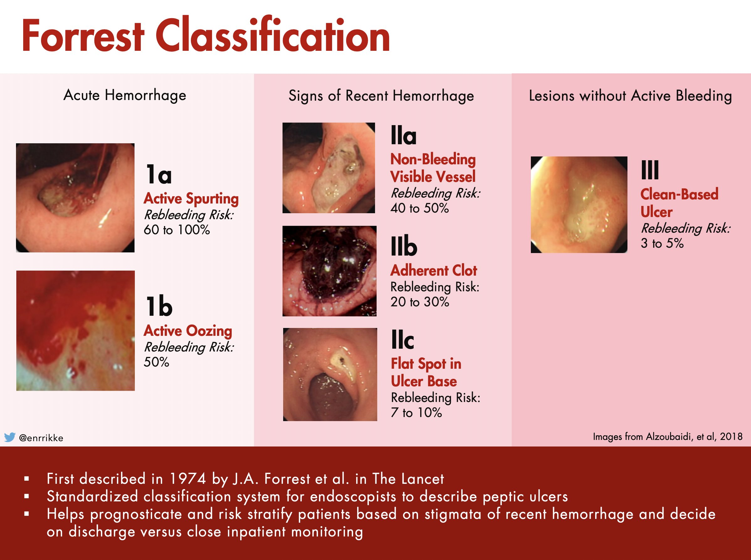

Slide 33
INVESTIGATIONS
Investigations
CBC
Electrolytes
Blood group and cross matching
Liver function test (those suspected of liver disease)
H. Pylori testing; rapid urease test, faecal antigen test, serum antibody test
Endoscopy(OGD)
Chest x-ray to detect free abdominal air (perforation)

Slide 34
MANAGEMENT cont..
Treatment
Initial management
Pharmacological therapy
Endoscopic therapy
Surgical therapy

Slide 35
TREATMENT cont
Initial management
Assess haemodynamic instability
Resuscitation
Haemogram and coagulation studies
Nasogastric tube (in/out)
Monitoring of vital signs and urine output

Slide 36
Management
General resuscitation
Abc protocal should be followed
Two large-bore cannula
Resuscitated by blood
Liver function test
Coagulatory profile
Tranexamic acid
Vit K
Prophylactic antibiotics

Slide 37
STG
S: octreotide (SC) 50–100µg 8hourly for 3days (infusion 50µg/hour for 72hours up to 5days)
OR
S: terlipressin: Adult (body weight up to 50 kg): Initially 2 mg every 4 hours until bleeding controlled, then reduced to 1 mg every 4 hours if required, maximum duration 48 hours. Adult (body weight 50 kg and above): Initially 2 mg every 4 hours until bleeding controlled, reduced if not tolerated to 1 mg every 4 hours, maximum duration 48 hours
AND
Band ligation of beeding esophageal varices (EVL); 3 – 6 shoots per session. OR Sclerotherapy (Histo Acryl Glue Inj. 5 %;( mixed with Lipiodol at a ratio 1:1) Ethanolamine oleate 5%); given 2 -5ml per varix up to 20ml per session
AND
B: ceftriaxone (IV) 1g 24hourly for 7day
Blood transfusion (PRBC, PLT concentrates and FFP) when required.

Slide 38
TREATMENT cont
Pharmacological Therapy
PPI’s (eg. pantoprazole)
Sandostation (octreotide acetate) to reduce blood flow in the GI sytem
H2 Antagonist inhibit gastric secretion

Slide 39
Management cont
Medical therapy
this is to decrease portal blood flow or decrease intrahepatic resistant
Terlipressin
Propanolol- non selective b blocker
Nitrates
Angiotensin receptor blocker
Baloon tamponade (sengstaken blakemore tube
Surgical therapy(Endoscopic therapy)
Electrocauterization of bleeders
Sclerotherapy
Endoscopic banding
Transjugular intrahepatic portosystemic stent shunt

Slide 40
Endoscopic therapy. Used In acute bleeding
This involves
band ligation- constricting rubber. strangulates the varices and causes thrombosis
Sclerotherapy- injection of sclerosant in the varices or adjacent to the varices
band ligation is better in in preventing rebleeding

Slide 41
Baloon tamponade (sengstaken blakemore tube)
This is used in profuse bleeding. Its temporary.
Its used in stopping bleeding before further interventions are taken
Re bleeding can reoccur
Aspiration pneumonia and ulcerations are common complications

Slide 42
???????????????
Qn, So I have given the patient medical therapy, and do endoscopic procedures but all have failed, even the balloon tamponade have failed.
WHAT CAN I DO?

Slide 43
Surgical interventions
Transjugular intrahepatic portosystemic stent shunt.
this is the main treatment if medical and endoscopic intervations have not responded.
Shunts are inserted via internal jugular vein—hepatic vein—hepatic parenchyma—branch of portal vein.
Then dilated with a ballon catheter and a stent is placed.
This procedure can cause perforation of a liver capsule—intraperitoneal hemmorage

Slide 44
Surgical shunts
Not commonly used as the rate of morbidity and mortality are high
This method is effective in preventing re bleeding of the varices
These methods tends to reduce the pressure in portal circulation by diverging the blood into low pressure systemic circulation.

Slide 45
PROGNOSTIC FACTORS
Clinical:
  Fresh red Haemodynamic instability
  blood in the emesis
  Haematochezia
  Increasing number of units transfused

Slide 46
  Age > 60 years
  Concurrent illness - Cardiovascular,
  pulmonary and Diabetes Mellitus
  Onset while hospitalized for other
  reasons
  Recurrent bleeding

Slide 47
2. Non Variceal bleeding
Causes of non variceal bleeding (RISK FACTORS)
Diagnosis
management

Slide 48
EXAMPLES OF NON VARICEAL BLEEDING
Peptic Ulcer Disease (PUD)
Gastritis / Duodenitis
- Subset due to NSAID use
Mallory-Weiss tears at GE junction
Esophagitis
Malignancy
Dieulafoy’s lesion
Nasopharyngeal bleed – swallowed blood
Other- Aortoenteric fistula, angiodysplasia, Crohn’s, hemobilia, hemosuccus pancreaticus

Slide 49
Risk factors for nonvariceal bleeding
Gastroesophageal procedures/surgeries
High alcohol consumption
Gastroesopghageal relux disease
Hyperemesis gravidarum
Bulimia nervosa

Slide 50
Clinical features of nonvariceal bleeding
Non bleeding varices are asymptomatic in most cases
Can also present with
Hematemesis :
Melena
Hypotension and Shock in severe cases(rare)
Syncope in severe cases(rare)

Slide 51
management
Urgent resuscitation of haemorrhagic shock.
Endoscopy to confirm the diagnosis-tear is seen in the lesser curvature.
Ryle's tube aspiration for 48-72 hours.
Endotherapy-injection adrenaline l: 10,000 dilution is effective. If not, haernoclipping can be done.
Multipolar electric coagulation
When all other measures fail, high gastrotomy and under running is necessary with 2-0 silk sutures.
  (IBD)

Slide 52
European Society of Gastrointestinal Endoscopy (ESGE) 2021 ten recomendations
in patients with acute upper gastrointestinal hemorrhage (UGIH) the use of the Glasgow– Blatchford Score (GBS) is recommended for pre-endoscopy risk stratification.
  Patients with GBS ≤ 1 are at very low risk of rebleeding, mortality within 30 days, or needing hospital-based intervention and can be safely managed as outpatients with outpatient endoscopy. Strong recommendation, moderate quality evidence.

Slide 53
(2). ESGE recommends that in patients with acute UGIH who are taking low-dose aspirin as monotherapy for secondary cardiovascular prophylaxis, aspirin should not be interrupted. If for any reason it is interrupted, aspirin should be restarted as soon as possible, preferably within 3–5 days. Strong recommendation, moderate quality evidence.
(3). ESGE recommends that following hemodynamic resuscitation, early (≤ 24 hours) upper gastrointestinal (GI) endoscopy should be performed. Strong recommendation, high quality evidence.

Slide 54
(4). ESGE does not recommend urgent (≤ 12 hours) upper GI endoscopy since as compared to early endoscopy, patient outcomes are not improved. Strong recommendation, high quality evidence.
(5). ESGE recommends for patients with actively bleeding ulcers (FIa, FIb), combination therapy using epinephrine injection plus a second hemostasis modality (contact thermal or mechanical therapy). Strong recommendation, high quality evidence.
(6). ESGE recommends for patients with an ulcer with a nonbleeding visible vessel (FIIa), contact or noncontact thermal therapy, mechanical therapy, or injection of a sclerosing agent, each as monotherapy or in combination with epinephrine injection. Strong recommendation, high quality evidence.

Slide 55
(7). ESGE suggests that in patients with persistent bleeding refractory to standard hemostasis modalities, the use of a topical hemostatic spray/powder or cap-mounted clip should be considered. Weak recommendation, low quality evidence.
(8). ESGE recommends that for patients with clinical evidence of recurrent peptic ulcer hemorrhage, use of a cap-mounted clip should be considered. In the case of failure of this second attempt at endoscopic hemostasis, transcatheter angiographic embolization (TAE) should be considered. Surgery is indicated when TAE is not locally available or after failed TAE. Strong recommendation, moderate quality evidence

Slide 56
(9). ESGE recommends high dose proton pump inhibitor (PPI) therapy for patients who receive endoscopic hemostasis and for patients with FIIb ulcer stigmata (adherent clot) not treated endoscopically. (a) PPI therapy should be administered as an intravenous bolus followed by continuous infusion (e. g., 80mg then 8 mg/hour) for 72 hours post endoscopy. (b) High dose PPI therapies given as intravenous bolus dosing (twice-daily) or in oral formulation (twice-daily) can be considered as alternative regimens. Strong recommendation, high quality evidence

Slide 57
(10). ESGE recommends that in patients who require ongoing anticoagulation therapy following acute NVUGIH (e. g., peptic ulcer hemorrhage), anticoagulation should be resumed as soon as the bleeding has been controlled, preferably within or soon after 7 days of the bleeding event, based on thromboembolic risk. The rapid onset of action of direct oral anticoagulants (DOACS), as compared to vitamin K antagonists (VKAs), must be considered in this context. Strong recommendation, low quality evidence.

Slide 58
MANAGEMENT cont.
Treatment
Initial management
Pharmacological therapy
Endoscopic therapy
Surgical therapy

Slide 59
TREATMENT cont
Initial management
Assess haemodynamic instability
Resuscitation
Haemogram and coagulation studies
Nasogastric tube (in/out)
Monitoring of vital signs and urine output

Slide 60
Management
General resuscitation
Abc protocal should be followed
Two large-bore cannula
Resuscitated by blood
Liver function test
Coagulatory profile
Tranexamic acid
Vit K
Prophylactic antibiotics

Slide 61
TREATMENT cont
Pharmacological Therapy
PPI’s (eg. pantoprazole) 80mg statthen 8 mg/hour) for 72 hours, then continue with a high dose twice a day in tab or iv
Sandostation (octreotide acetate) to reduce blood flow in the GI sytem
H2 Antagonist inhibit gastric secretion

Slide 62
Management summary overview
Medical therapy
this is to decrease portal blood flow or decrease intrahepatic resistant
Terlipressin
Propanolol- non selective b blocker
Nitrates
Angiotensin receptor blocker
Baloon tamponade (sengstaken blakemore tube
Surgical therapy(Endoscopic therapy)
Electrocauterization of bleeders
Sclerotherapy
Endoscopic banding
Transjugular intrahepatic portosystemic stent shunt

Slide 63
Reminder:
ENDOSCOPIC THERAPY
Endoscopic intervention is only required in Forrest Ia, Ib, IIa and probably IIb at first to stop the active bleeding (Ia, Ib) and prevent subsequent rebleeding.

Slide 64
FORREST CLASSIFICATION

Slide 66
ACUTE GASTRIC MUCOSA LESION
A general term applied to conditions characterized by the acute development of mucosal lesions in the form of erythema, mucosal hemorrhage, erosions and ulcerations in the mucosa of the stomach and duodenum.(Gastritis/Duodenitis –eg: Subset due to NSAID use AND OTHER CAUSES).

Slide 67
Aorta enteric Fistula
Primary aortoduodenal fistula are rare previous abdominal aortic repair (aortic grafting), inflammatory or infectious aortitis.
Mechanism: Development of psuedoaneurysm and subsequent fistulalization into overlying duodenum.
Presents with massive and fatal, sentinel bleed.
Bleeding from the distal 3rd or 4th part of the duodenum is diagnostic.
CT Scan with iv contrast: Air around graft, Possible psedoaneurysm, IV contrast in duodenal lumen(rarely).
Treatment: Ligation of aorta proximal to the graft, removal of the infected prosthesis and extra anatomical bypass.

Slide 68
TREATMENT cont
Surgical therapy
Electrocauterization of bleeders
Sclerotherapy
Endoscopic banding

Slide 69
PROGNOSTIC FACTORS
Clinical:
  Fresh red Haemodynamic instability
  blood in the emesis
  Haematochezia
  Increasing number of units transfused

Slide 70
  Age > 60 years
  Concurrent illness - Cardiovascular,
  pulmonary and Diabetes Mellitus
  Onset while hospitalized for other
  reasons
  Recurrent bleeding

Slide 71
LOWER GI BLEEDING
Bleeding from anywhere below ligament of treitz
Bleeding from small intestines, large intestines, sigmoid colon
Rectum or anal canal
Most often the colon is involved
Incidence increases with age
Most cases of lower GI bleeding resolve spontaneously

Slide 72
CAUSES OF LOWER GI BLEEDING
  Diverticulosis
  Chron’s disease (IBD)
  Ulcerative colitis (IBD)
  Malignancy
  Benign anorectal diseases such as hemorrhoids, anal fissure
  Vascular malformations, angiodysplasia

Slide 73
CLINICAL FEATURES
Presentation ranges from intermittent mild bleeding to severe haemorrhage with haemodynamic instability.
The stool of a person with a lower gastrointestinal bleed is a good indication of where the bleeding is occurring. Black tarry appearing stools medically referred to as melena usually indicates blood that has been in the GI tract for at least 8 hours. Melena is four-times more likely to come from an upper gastrointestinal bleed than from the lower GI tract; however, it can also occur in either the duodenum and jejunum, and occasionally the portions of the small intestine and proximal colon. Bright red stool, called hematochezia, is the sign of a fast moving active GI bleed. The bright red or maroon color is due to the short time taken from the site of the bleed and the exiting at the anus. The presence of hematochezia is six-times greater in a LGIB than with a UGIB

Slide 74
MANAGEMENT
Investigations
CBC
Electrolytes
Blood group and cross matching
Liver function test (those suspected of liver disease)
Anoscopy or sigmoidoscopy
Colonoscopy

Slide 75
MANAGEMENT cont
Treatment
According to expert opinion, the blood transfusion threshold for patients with colonic bleeding is a haemoglobin value <9 g/dL (note this is different for the evidence-based threshold for UGI bleeding).
If the patient is hemodynamically unstable, resuscitate the patient before diagnostic studies are performed. Most episodes of LGI bleeding resolve spontaneously.
Colonoscopy is recommended early, usually within the first 48 hours of admission, and endoscopic therapy is used to control continued bleeding.
If colonoscopy does not identify a discrete lesion or endoscopic therapy does not control the bleeding, interventional angiography or surgery may be indicated.
Patients with angiodysplasia in the setting of AS (Heyde Syndrome) may benefit from valve replacement surgery

Slide 76
Questions
Which conditions are included in the differential diagnoses of upper gastrointestinal bleeding (UGIB)?
What is the role of endoscopy in the workup of upper gastrointestinal bleeding (UGIB)?
Colonoscopy is diagnostic and therapeutic and is more accurate than bleeding scans and angiography for GI bleeds. T/F
The most common cause of a lower GI bleed is?
Diverticulosis B) Cancer C) Hemorrhoids D) AV malformations

Slide 77
Which type of gi bleeding is more common in the hospital setting ie about 75% of cases
Upper gi bleeding
Lowe gi bleeding
The most common cause of upper GI bleed is?
Variceal bleeding
Non variceal bleeding

Slide 78
REFERENCES
Shenoy K; Manipal manual of surgery; 4th edition
Bailey and Love’s short practice of surgery; 26th edition
Dr. B. Selvaraj professor of surgery notes

